Slide 1

.
DEPARTMENT OF INFORMATION TECHNOLOGY
NOISE POLLUTION MONITORING
Team name : Proj_224788_Team_4
Team members :
DHARSHNI K (113321205011)
SNEHA V (113321205049)
SHARMILA V (113321205047)
AGNAL CAJOLIN X.I (113321205003)

Slide 2
PROJECT
Creating a Noise pollution Monitoring (Internet of Things) involves a combination of hardware, software, and connectivity. While web development technologies may not be the only requirement, they can play a crucial role in creating a user interface for monitoring and controlling the air conditions processing.

Slide 3
OBJECTIVES
Real-Time Monitoring: Implement a system capable of continuously monitoring noise levels in various locations within a designated area, providing up-to-the-minute data.
Data Collection and Storage: Develop a robust data collection and storage mechanism to capture noise data, including decibel levels, timestamps, and location information, and store it securely for future analysis.
Data Analysis: Utilize advanced data analytics to process and interpret noise data, identifying trends, patterns, and noise pollution hotspots.
Alerts and Notifications: Implement a real-time alerting system that issues notifications to relevant authorities and the public when noise levels exceed permissible limits, enabling prompt action.

Slide 4
IoT device setup
1. Select Suitable Sensors:
Choose appropriate noise sensors (microphones or sound level meters) with the necessary sensitivity and accuracy to measure noise levels. Make sure they are compatible with IoT connectivity options.
2. Choose IoT Hardware:
Select IoT hardware components such as microcontrollers (e.g., Raspberry Pi, Arduino), IoT development boards (e.g., ESP8266, ESP32), or specialized IoT devices designed for environmental monitoring.
3. Connect the Sensors:
Connect the noise sensors to your chosen IoT hardware. Ensure the sensors are properly calibrated.
4. Power Supply:
Provide a reliable power source for your IoT devices, which may involve using batteries, solar panels, or a continuous power supply if available.
5. IoT Communication:
Choose a communication protocol to transmit data from the sensors to a central server or cloud platform. Common options include Wi-Fi, cellular networks, LoRa (Long Range), Sigfox, or NB-IoT. Ensure the connectivity is reliable in the target environment.
6. Data Processing and Storage:
Set up a central server or cloud platform to receive, process, and store the data from your IoT devices. This platform should handle data analysis, visualization, and storage.
7. Data Security:
Implement strong security measures to protect the data and the IoT devices from unauthorized access.
8. Data Analysis Software:
Develop or integrate software to analyze the noise data in real-time. This may include identifying noise patterns, calculating noise levels, and sending alerts when thresholds are exceeded.
9. Visualization and Reporting: - Create a user-friendly interface to visualize the noise data, generate reports, and provide insights to stakeholders. Consider using web dashboards or mobile apps.
10. Data Analysis and Improvement: - Continuously analyze the data to identify trends and patterns, and use this information to improve noise mitigation strategies or adapt monitoring locations as needed.

Slide 5
Platform development
1. Choose a Technology Stack:
Select the appropriate technology stack, including programming languages, frameworks, and databases. Common choices include Python, Node.js, Django, Flask, React, and databases like PostgreSQL or MongoDB.
2. Data Collection and Integration:
Implement mechanisms to collect data from noise sensors (IoT devices). This can involve setting up data ingestion pipelines, APIs, or direct sensor connections.
3. Data Storage:
Design a database structure to store noise data efficiently. Choose a database management system that suits your data volume and access patterns.
4. Real-Time Data Processing:
Develop real-time data processing capabilities to analyze incoming noise data, calculate metrics (e.g., sound levels), and detect anomalies or exceedances of predefined thresholds.
5. Geospatial Integration (Optional):
If your platform includes location-based monitoring, integrate a Geographic Information System (GIS) to handle geospatial data and mapping.
6. User Management and Authentication:
Implement user management and authentication systems to ensure that only authorized individuals can access and interact with the platform.
7. Data Visualization:
Create interactive dashboards and visualization tools to display noise data in a user-friendly way. This can be done using libraries like D3.js, Plotly, or Mapbox for geospatial visualization.
8. Alerting and Notifications:
Set up an alerting system to notify users when noise levels exceed predefined thresholds. This can include email alerts, SMS, or push notifications.
9. Reporting and Analytics: - Develop reporting features that allow users to generate custom reports and analyze historical noise data. Incorporate data analytics tools as needed.
10. Data Export: - Allow users to export data in various formats (e.g., CSV, PDF) for further analysis or compliance reporting.
11. User Interfaces: - Create web-based or mobile interfaces for end-users, administrators, and data analysts. Ensure that the interfaces are responsive and user-friendly.
12. Data Security: - Implement strong security measures to protect data, including encryption, access controls, and regular security audits.
13. Compliance and Regulations: - Ensure that the platform complies with relevant noise pollution regulations and standards, especially if it's used for compliance monitoring.

Slide 6
The Python script for noise monitoring:
import os
import time
import numpy as np
import pyaudio
import requests
# Constants for your configuration
API_ENDPOINT = 'https://your-api-endpoint.com/noise-data'
SAMPLE_RATE = 44100 # Audio sample rate (Hz)
RECORD_SECONDS = 5 # Duration of each recording (seconds)
# Initialize PyAudio
p = pyaudio.PyAudio()
def record_audio():
print("Recording audio...")
stream = p.open(format=pyaudio.paInt16, channels=1, rate=SAMPLE_RATE, input=True, frames_per_buffer=1024)
frames = []
for _ in range(0, int(SAMPLE_RATE / 1024 * RECORD_SECONDS)):
data = stream.read(1024)
frames.append(data)
stream.stop_stream()
stream.close()
audio_data = b''.join(frames)
return audio_data

Slide 7
def main():
while True:
audio_data = record_audio()
# Calculate noise level (you can use a more complex algorithm)
noise_level = np.frombuffer(audio_data, dtype=np.int16).max()
print(f"Noise level: {noise_level} dB")
# Send data to the server
payload = {
"noise_level": noise_level
}
try:
response = requests.post(API_ENDPOINT, json=payload)
if response.status_code == 200:
print("Data sent successfully.")
else:
print(f"Failed to send data. Status code: {response.status_code}")
except Exception as e:
print(f"Failed to send data: {str(e)}")
time.sleep(60) # Wait for 1 minute before taking the next reading
if __name__ == '__main__':
main()

Slide 8
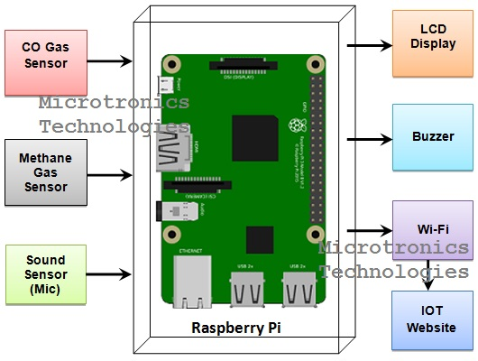
IOT SENSOR DESIGN DIAGRAM

Slide 9
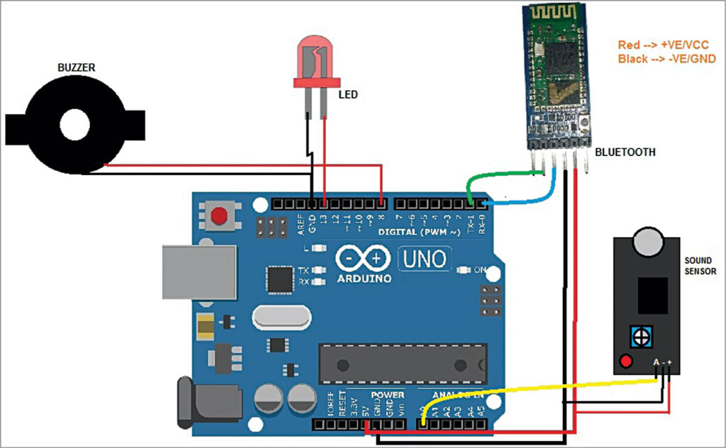
screenshots of the IoT devices

Slide 10
schematics
Components Needed:
Microcontroller: Arduino Uno or a similar board (for simplicity).
Sound Sensor: A microphone sensor or a sound level sensor (e.g., LM386-based) to measure noise levels.
Wi-Fi Module: ESP8266 or ESP32 for IoT connectivity.
Power Source: A 5V power supply or a rechargeable battery.
Voltage Regulator: LM7805 or a similar voltage regulator to provide a stable 5V power supply.
Resistors: To interface the sound sensor with the microcontroller.
LEDs: To indicate device status.
Capacitors: For noise filtering and stability.
Breadboard or PCB: To assemble the components.

Slide 11
Schematic Overview:
+-----------------+
| |
| | +----------+
Sound Sensor | Microcontroller| | Wi-Fi |
+--------| (e.g., Arduino)| | Module |
| | | +----+-----+
| +--------+--------+ |
| | | Wi-Fi
| | | Data
| | | Internet
| | |
| +--------+--------+ |
| | | |
+--------| Voltage Regulator| |
| | (LM7805) | |
| | | |
| +--------+--------+ |
| | |
| | |
| +--------+--------+ |
| | | |
| | LEDs | |
| | | |
| +-----------------+ |
| |
+----------------------------------+

Slide 12
Project in detail:
1. Project Objectives:
The primary objective of this project is to design and implement an IoT-based system for monitoring noise pollution in urban . This system will collect real-time noise data, analyze it, and make the data accessible to authorities, researchers, and the public.
Specific objectives include:
Continuously monitor noise levels at various locations.
Analyze noise data to identify patterns, sources, and trends.
Provide real-time alerts when noise levels exceed permissible limits.
Create user-friendly interfaces for data visualization and reporting.
Encourage community engagement and awareness regarding noise pollution.
2. Hardware and Sensors:
Select appropriate hardware components for noise data collection, such as sound sensors (e.g., microphones or sound level meters), microcontrollers (e.g., Arduino or Raspberry Pi), IoT communication modules (e.g., Wi-Fi, cellular, LoRa), and power sources (batteries or solar panels). Ensure the sensors are sensitive, accurate, and weather-resistant.
3. Data Collection and Communication:
Connect the sound sensors to microcontrollers, which process and digitize the analog noise data.
Use IoT communication modules to transmit the data to a central server or cloud platform for analysis.

Slide 13
5. Real-Time Data Analysis:
Develop software to analyze noise data in real-time to calculate noise levels and detect anomalies.
Use machine learning and data analytics techniques to identify patterns and trends in noise pollution.
6. User Interfaces:
Create user-friendly web-based or mobile interfaces for various stakeholders, including authorities, researchers, and the public.
Provide dashboards with real-time noise data visualization, historical data analysis, and geographic mapping if necessary.
7. Alerts and Notifications:
Set up an alerting system to notify relevant parties when noise levels exceed predefined thresholds. Alerts can be sent via email, SMS, or push notifications.
8. Reporting and Analytics:
Enable users to generate custom reports and perform in-depth data analytics.
Provide data export options for further analysis or regulatory compliance.
9. Geographic Information System (GIS) Integration:
If the project involves multiple monitoring locations, integrate GIS for geospatial context and mapping of noise data.
10. Compliance and Regulations:
Ensure that the monitoring system complies with local noise pollution regulations and standards. Provide compliance reporting features if required.

Slide 14
CONCLUSION :
In conclusion, an IoT device for noise pollution monitoring is a valuable tool in addressing the growing concern of noise pollution in urban and industrial environments. Such devices can provide real-time data, enabling informed decisions for mitigating the effects of noise pollution.

Slide 15
THANK YOU

